Slide 1

Python Programming
Library System Project

Slide 2
Background
Many libraries have a library system
Helps to add books and searching for them
Maintains information about the borrowed books
We will create a simple version of this classical system
The main user of the system is an admin
Who might add a book, user or perform some relevant operation
You don’t need to provide login/logout functionalities in this console system
The system starts with a menu
It shows all possible choices
The admin selects a choice.
Some operation is performed
Then the main menu is listed again

Slide 3
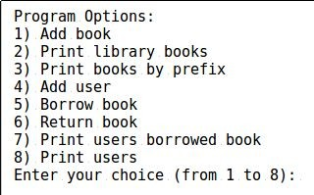
The menu
Take a minute to read these choices

Slide 4
Books operations: Adding a book
Every system needs data. The core data here is the book and users
The admin needs to be able to add books
Each book has the following information
id, name and quantity
Example: 101, Cpp How To Program, 7
We have 7 copies for book Cpp How To Program
The book ID is 101

Slide 5
Books operations: Searching for a book
Searching your database of books is a typical operation
We will search the system using the book name.
Instead of the complete book name, we will allow a prefix
Prefix: The first letters of a word
Assume we have 3 books in the system, their names:
CppHowToProgram, CppForDummies, CppForAdvancedLevels, CoreJava
Query
Cpp ⇒ CppHowToProgram, CppForDummies, CppForAdvancedLevels
CppFo ⇒ CppForDummies, CppForAdvancedLevels
Core ⇒ CoreJava
Java ⇒ Nothing

Slide 6
Book Operations: Listing books
Another typical operations is to just list all books in the system

Slide 7
Book Operations: Listing users borrowed a book
Given that several users may borrow a book, the admins may want to know who borrowed what.
Remember we have several copies per book.
Input: Book Name
E.g. Math1
Output: list of the user names who borrowed the book
E.g. Mostafa, John, Mark, Ali

Slide 8
User Operations: Add a user
Each user has only an Id and name
We only request 2 operations
Borrowing a book
Returning a book

Slide 9
User Operation: Borrow a book
Borrowing books is a repetitive scenario in libraries
Each book already has a specific number of copies (the quantity)
To borrow a book, this quantity must be > 0
Otherwise, this book can’t be borrowed
After borrowing, the quantity must be decreased
The admin enters the user name and the book name
If there are enough quantity of the book, the system does the following:
Mark that this user borrowed a copy
Decrease the quantity with 1
If there is no available copies, the system notifies the admin

Slide 10
User Operation: Return a book
Same logic, but this time the system does the reverse:
Mark that the user returned a copy
Increment the current quantity

Slide 11
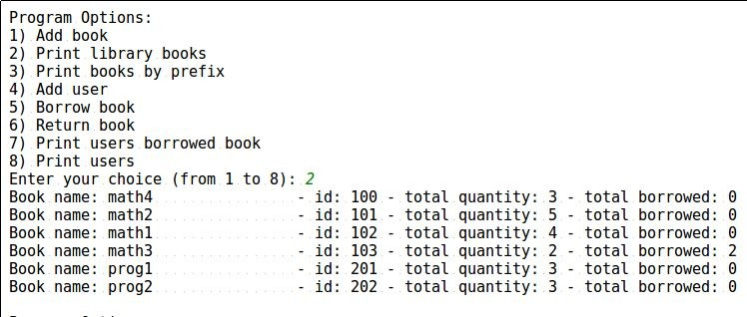
Library System: Start with dummy data!

Slide 12
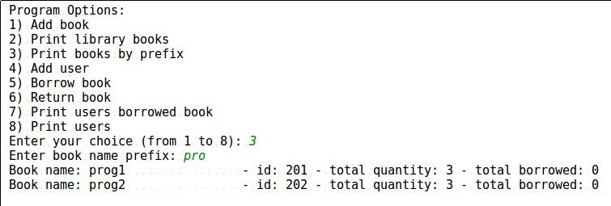
Library System

Slide 13
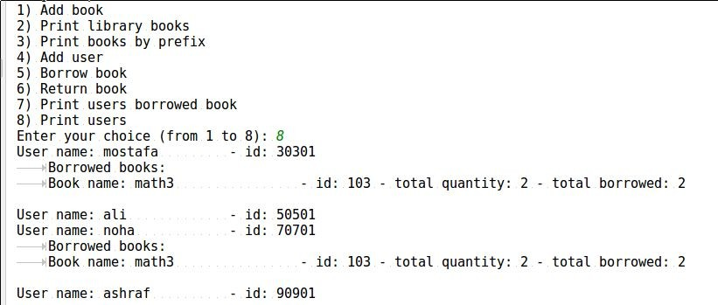
Library System: Start with dummy data!

Slide 14
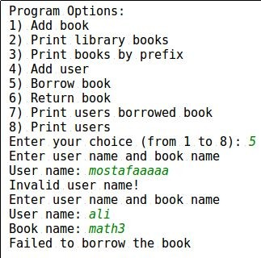
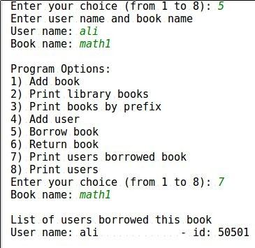
Library System: Handle wrong scenarios

Slide 15
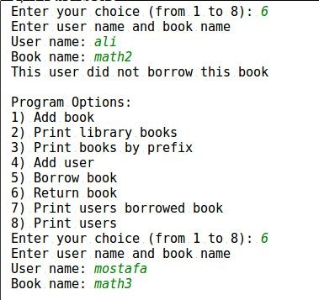
Library System: Return book

Slide 16
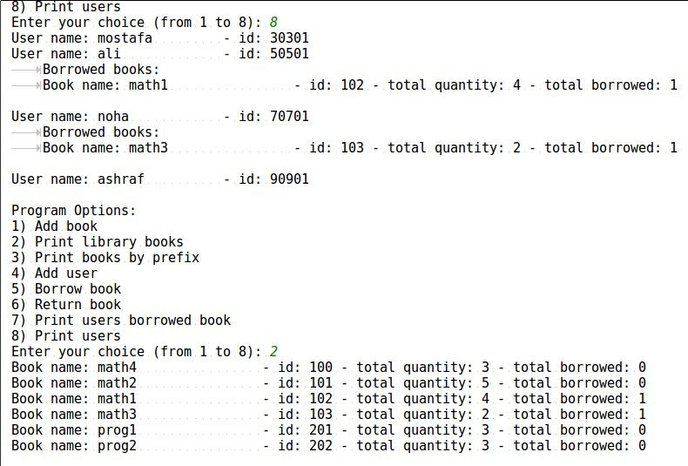
Library System: Verify Correctness

